Slide 1
Modeling differential trail search
Marine Minier – Loria, CARAMBA Team
Joint work with C. Prud’homme, P. Derbrez, S. Delaune, P. Huynh, V. Mollinard
Code by P. Huynh and S. Delaune
Slides by M. Simard
Marine Minier
EJCIM 2024| 17-21 Juin 2024 | Nantes

Slide 2
RoadMap
Introduction to differential cryptanalysis
How to model that? With what?
Step 1
Step 2
Results
Conclusion
2/44

Slide 3
Introduction
Thank you to Marc Simard for wonderful slides!
3/44

Slide 4
Cryptography Principle
0111100001000100
01000010011011110110111001101010011011110111010101110010
00110111010100010110111000110011011110010110010101110000
Cipher
Decipher
Hello
7Qn3yep
7Qn3yep
4/44

Slide 5
Cryptography Principle
0111100001000100
01000010011011110110111001101010011011110111010101110010
0011101000101000
00110111010100010110111000110011011110010110010101110000
0111100001000100
Cipher
01000010011011110110111001101010011011110111010101110010
Decipher
00110111010100010110111000110011011110010110010101110000
As
symetric
Cryptography
5/44

Slide 6
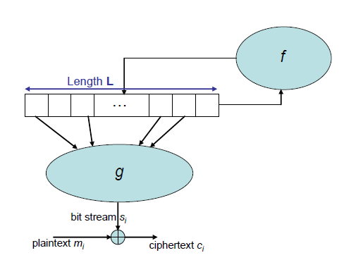
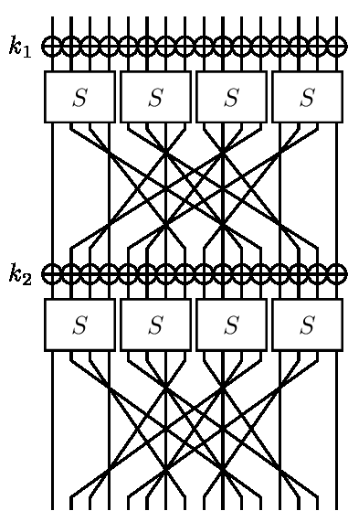
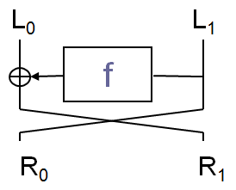
How to Cipher?
Stream Ciphers
Block Ciphers
Repeat rounds many many times
Feistel (as DES): 1 round
SPN (as AES): 1 round
6/44

Slide 7
Key Schedule
SPN Example
Cryptography: Theory and Practice
Stinson, CRC Press, 1995
S
S
S
S
1
1
1
1
⊕
S
⊕
S
⊕
S
⊕
S
⊕
2
2
2
2
K
K
K
K
K
1
2
3
4
5
S
S
S
S
3
3
3
3
S
S
S
S
4
4
4
4
Round 1
Round 2
Round 3
Final Round
7/44

Slide 8
Elementary Operations
Substitution-Permutation Network (SPN)
Linear Operation
1
1
Bits Permutation
Linear
0
0
XOR
Linear
0
1
S-box
Non Linear
1
0
8/44

Slide 9
XOR
Linear Operation
A | B | A ⊕ B
0 | 0 | 0
0 | 1 | 1
1 | 0 | 1
1 | 1 | 0
1
0
0
1
0
0
1
1
0
1
1
0
$∀\text{A}∈𝔽_{2}$ ,
A $⊕$ A = 0
9/44

Slide 10
XOR
Linear Operation
A | B | A ⊕ B
0 | 0 | 0
0 | 1 | 1
1 | 0 | 1
1 | 1 | 0
1
1
0
0
0
1
1
0
10/44

Slide 11
S-box
1
(substitution box)
0
0
Non Linear Operation
0
1
?
Describes a random permutation from ${𝔽_{2}}^{n}$ to ${𝔽_{2}}^{n}$
0
S
?
0
?
4-bit S-box Example:
1
?
x | 0 | 1 | 2 | 3 | 4 | 5 | 6 | 7 | 8 | 9 | a | b | c | d | e | f
S[x] | c | 6 | 9 | 0 | 1 | a | 2 | b | 3 | 8 | 5 | d | 4 | e | 7 | f
11/44

Slide 12
Cryptanalysis
We look for the plaintext, or better the used key
Linear Cryptanalysis
Differential Cryptanalysis
Known Plaintext Attacks
Chosen Plaintext Attacks
12/44

Slide 13
Differential Cryptanalysis
Elementary Principle
x
y
Transformation
x $⊕$ $Δ$x =
= y $⊕$ $Δ$y
x’
y’
Input Difference :
$Δ$x (= x $⊕$x’)
Output Difference :
$Δ$y (= y $⊕$ y’)
We associated at each pair of differences $Δ$x $→$ $Δ$y a probability p
p ( $Δ$x $→$ $Δ$y ) is the probability to get the difference $Δ$y as output knowing that the input difference is $Δ$x
13/44

Slide 14
Differential Cryptanalysis
Linear / non linear
Linear operations:
L(x)⊕L(x’)=L(x⊕x’)=L(𝚫x)
with probability 1!
Non-linear operations:
S-boxes
DDT

Slide 15
Differential Distribution Table (DDT)
x
y
1001
0101
S
(= S[x])
Transformation
$Δ$x = 0110
$Δ$y = 1110
1111
= y $⊕$ $Δ$y
y’
x $⊕$ $Δ$x =
x’
1011
(= S[x’])
$∀\text{(}Δ\text{x}\text{,}Δ\text{y}\text{) }∈ {{{(𝔽}_{2}}^{n})}^{2}$ ,
Looking at all couples (x,x’) having difference $Δ$x,
# { (x,x’) $∈$ ${{{(𝔽}_{2}}^{n})}^{2}$ | (x $⊕$ x’ = $Δ$x) $∧$ (S[x] $⊕$ S[x’] = $Δ$y) }
Number of couples with a $Δ$y output
p ( $Δ$x $→$ $Δ$y ) =
# { (x,x’) $∈$ ${{{(𝔽}_{2}}^{n})}^{2}$ | (x $⊕$ x’ = $Δ$x) } = $2^{n}$
Nb possible couples in total
Thus, p ( 0110$→$ 1110 ) $≠$ 0.
14/44

Slide 16
Differential Distribution Table (DDT)
4-bit S-box Example
$Δ$y
 | 0 | 1 | 2 | 3 | 4 | 5 | 6 | 7 | 8 | 9 | a | b | c | d | e | f
0 | 16 | 0 | 0 | 0 | 0 | 0 | 0 | 0 | 0 | 0 | 0 | 0 | 0 | 0 | 0 | 0
1 | 0 | 0 | 0 | 2 | 0 | 0 | 0 | 2 | 0 | 2 | 4 | 0 | 4 | 2 | 0 | 0
2 | 0 | 0 | 0 | 2 | 0 | 6 | 2 | 2 | 0 | 2 | 0 | 0 | 0 | 0 | 2 | 0
3 | 0 | 0 | 2 | 0 | 2 | 0 | 0 | 0 | 0 | 4 | 2 | 0 | 2 | 0 | 0 | 4
4 | 0 | 0 | 0 | 2 | 0 | 0 | 6 | 0 | 0 | 2 | 0 | 4 | 2 | 0 | 0 | 0
5 | 0 | 4 | 0 | 0 | 0 | 2 | 2 | 0 | 0 | 0 | 4 | 0 | 2 | 0 | 0 | 2
6 | 0 | 0 | 0 | 4 | 0 | 4 | 0 | 0 | 0 | 0 | 0 | 0 | 2 | 2 | 2 | 2
7 | 0 | 0 | 2 | 2 | 2 | 0 | 2 | 0 | 0 | 2 | 2 | 0 | 0 | 0 | 0 | 4
8 | 0 | 0 | 0 | 0 | 0 | 0 | 2 | 2 | 0 | 0 | 0 | 4 | 0 | 4 | 2 | 2
9 | 0 | 2 | 0 | 0 | 2 | 0 | 0 | 4 | 2 | 0 | 2 | 2 | 2 | 0 | 0 | 0
a | 0 | 2 | 2 | 0 | 0 | 0 | 0 | 0 | 6 | 0 | 0 | 2 | 0 | 0 | 4 | 0
b | 0 | 0 | 8 | 0 | 0 | 2 | 0 | 2 | 0 | 0 | 0 | 0 | 0 | 2 | 0 | 2
c | 0 | 2 | 0 | 0 | 2 | 2 | 2 | 0 | 0 | 0 | 0 | 2 | 0 | 6 | 0 | 0
d | 0 | 4 | 0 | 0 | 0 | 0 | 0 | 4 | 2 | 0 | 2 | 0 | 2 | 0 | 2 | 0
e | 0 | 0 | 2 | 4 | 2 | 0 | 0 | 0 | 6 | 0 | 0 | 0 | 0 | 0 | 2 | 0
f | 0 | 2 | 0 | 0 | 6 | 0 | 0 | 0 | 0 | 4 | 0 | 2 | 0 | 0 | 2 | 0
Table obtained with:
x | 0 | 1 | 2 | 3 | 4 | 5 | 6 | 7
S[x] | e | 4 | d | 1 | 2 | f | b | 8
x | 8 | 9 | a | b | c | d | e | f
S[x] | 3 | a | 6 | c | 5 | 9 | 0 | 7
$Δ$x
p (1010$→$ 1000) $=$ $\frac{\text{6}}{\text{16}}$
S
15/44

Slide 17
Differential Trail Search
Looking for the best differential characteristic
S
S
S
S
⊕
S
⊕
S
⊕
S
⊕
S
⊕
K
K
K
K
K
1
2
3
4
5
S
S
S
S
S
S
S
S
$$\frac{\text{6}}{\text{16}}$$
p (0100$→$ 0101)
$$\frac{\text{8}}{\text{16}}$$
$$\frac{\text{6}}{\text{16}}$$
$$\frac{\text{27}}{\text{1024}}$$
Probability to obtain with an input difference : 0000 1011 0000 0000, la the difference before the last round: 0000 0110 0000 0110
p (1011$→$ 0010)
×
p (0100$→$ 0110)
×
×
=
$$\frac{\text{6}}{\text{16}}$$
p (0100$→$ 0101)
16/44

Slide 18
Differential Trail Search
Last round
S
Differential characteristic with the best proba:
S
p (0000 1011 0000 0000$→$ 0000 0110 0000 0110) $=$ $\frac{\text{27}}{\text{1}\text{024}}$
K
5
S
S
~
~
We can attack bits 5 to 8 and 13 to 16 of
( x , x’ )
( y , y’ )
( z , z’ )
We retain the subkey with whom we have the higher number of occurrences of
couples ( y , y’ ) coherents with the best differential characteristic
K
5
~
~
chosen such that $Δ$x = 0000 1011 0000 0000
Partial deciphering of (z, z’) according all the possible subkeys K
obtained after ciphering
5
17/44

Slide 19
What are we doing?
Know and improve existing attacks
Create new attacks
Why?
To be convinced about the security of current schemes
To elaborate new secure schemes
18/44

Slide 20
Modeling
Cryptanalysis Problem
Problem MILP
MILP Solver
Mixed Integer Linear Programming
Gurobi
Problem
Problem SAT
SAT Solver
Solution
Boolean Satisfiability
MiniZinc
Problem CP
CP Solver
Constraint Programming
Choco
Modeling
Resolution
19/44

Slide 21
How to model?
Here are my slides and there are less, less…
20/44

Slide 22
SC: Sboxes
AC/ART: Add Constants/Add Round Tweakey
Round Tweakey is like a Subkey
What scheme?
The SKINNY Family of Block Ciphers and its Low-Latency Variant MANTIS
Beierle, Jean, Kölbl, Leander, Moradi, Peyrin, Sasaki, Sasdrich & Sim
CRYPTO 2016
SKINNY
2 versions: SKINNY-64 and SKINNY-128
Key size variable
32 to 56 rounds
Non linear part
Each cell, apply S
Linear Part
How to model?
Round function
21/44

Slide 23
How to model?
Two steps
Step 1, abstract cell differences δx with Boolean variables Δx in {0,1}
Find the path with the minimal weight
Active S-box means ΔSx = 1!
because less active S-box = better proba!
Then go to Step 2!
Step 2
Input the solutions of Step 1
Then try to instantiate cell differences δx to maximize the overall probability p
How to do that?
22/44

Slide 24
Step 1
23/44

Slide 25
Step 1 (remember BOOLEAN): SC
SC: SubCells: A 4-bit or an 8-bit S-box is applied to each cell of the state.
At cell level, use the DDT: δx => δy with a certain probability
For Step 1 really simple model
At Boolean Level: S-box is bijective !
Thus if Δx=1, then Δy=1 => active S-box
if Δx=0, then Δy=0 => inactive S-box
Thus Good news! No effect!
S
S
Δx= Δy=1
Δx= Δy=0
24/44

Slide 26
Step 1: AC and ART
AddConstants: Round constants are XORed to the state
AddRoundTweakey: The first and second rows of all tweakey arrays are extracted and XORed
No differences are inserted through AC and ART (if yes, more tricky…)
So, do nothing to model ;o)
25/44

Slide 27
Step 1: ShiftRows
ShiftRows. The rows of the cipher state cell array are rotated to the right (not to the left as in the AES!)
By 1 for the first row
By 2 for the second
By 3 for the third
So, at cell level: δy[i+j mod 4,j]=δx[i,j]
So, at boolean level: Δy[i+j mod 4,j]= Δx[i,j]
26/44

Slide 28
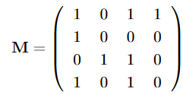
Step 1: MixColumns
MixColumns. Each column of the cipher internal state array is multiplied by the 4x4 binary matrix
Thus,
δy[0,j]=δx[0,j] ⊕ δx[2,j] ⊕ δx[3,j]
δy[1,j]= δx[1,j]
δy[2,j]=δx[1,j] ⊕ δx[2,j]
δy[3,j]=δx[0,j] ⊕ δx[2,j]
Same for Boolean variables
BUT ⊕ is not an available operation in the model, so…
27/44

Slide 29
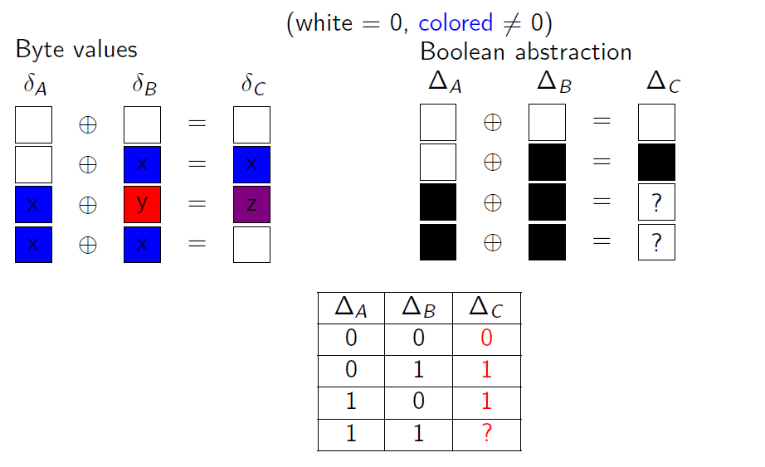
Step 1: BUT the XOR?
28/44

Slide 30
Step 1: we’ve got all
Let’s move to the MiniZinc Model
https://gitlab.inria.fr/minier/TP_ecole_ete
Run this model with r=5
Also, model in CP but more wordy…
29/44

Slide 31
Step 1: what we have
4 models we tested: 1 MILP, 1 MiniZinc, 1 CP, 1 Ad-Hoc (C++)
Step 1: 2 substeps
First, Minimize
Second, Enumerate
Lessons learnt:
MinZinc and CP are too slow
When you deviate from the optimal, MILP becomes too slow too
Only the Ad-Hoc model is able to provide us what we want
In TK1 (when differences are authorized also in the key), SKINNY-128 with 14 rounds:
3 solutions for optimal value v = 45
897 solutions for v = v + 5 = 50
137 019 solutions for v = v + 10 = 55
7 241 601 solutions for v = 59
30/44

Slide 32
Step 2
31/44

Slide 33
Where we are now
With Step 1, we have the differential trails of minimal weights with Boolean variables
Now, let us try to instantiate those trails to maximize the overall probaility p
Some trails could not be instantiated: they are called non-consistent BUT some are instantiable, we are looking for those trails
So, take as input all the Step 1 solutions
32/44

Slide 34
Step 2: model each SKINNY transformation
With δx variables with integer domains
SC: SubCells. An S-box
If, there is an active S-box, model the DDT:
(δx, δy, -10.log₂ (p(δx$→$δy))) under a table constraint
To discard negative value and keep only integer value
Objective function becomes: Minimize sum(-10.log₂ (p(δx$→$δy)))
33/44

Slide 35
Step 2: model each SKINNY transformation
AC and ART: no effect in differential cryptanalysis
ShiftRows: Direct implementation, just shift to the right
MixColumns: Direct implementation, just XOR through table constraint
The XOR is implemented through a table constraint
34/44

Slide 36
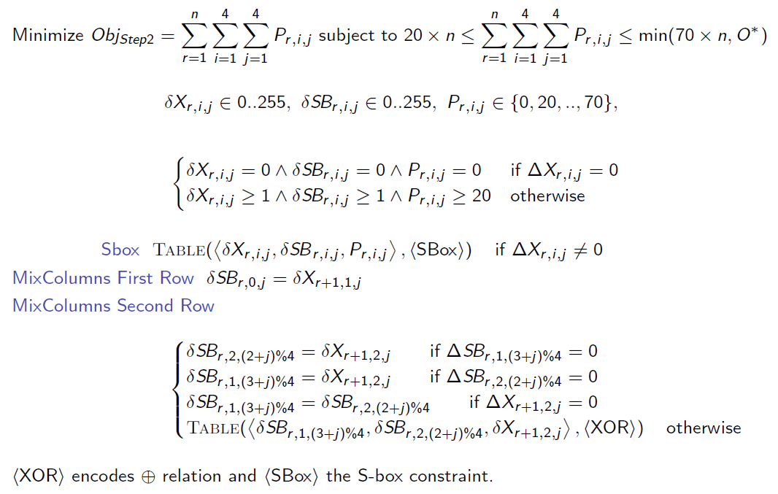
Step 2: all in 1!
35/44

Slide 37
Step 2: only CP
Only CP could model Step 2, the other approaches could not efficiently be used to model variables with integer domains
Go to the code: https://gitlab.inria.fr/minier/TP_ecole_ete
We will see it in the TP
36/44

Slide 38
Step 2: more attacks SK and TK1
I will show some of our results but I must introduce the other attacker models TK1, TK2 and TK3 before
SK: differences only located in the plaintext block
TK1: differences in the plaintext block BUT also in the key, the so-called lane
TK1: one lane
37/44

Slide 39
Step 2: more attacks TK2 and TK3
TWEAKEY framework
TK2: 2 lanes
TK3: 3 lanes
38/44

Slide 40
Results
39/44

Slide 41
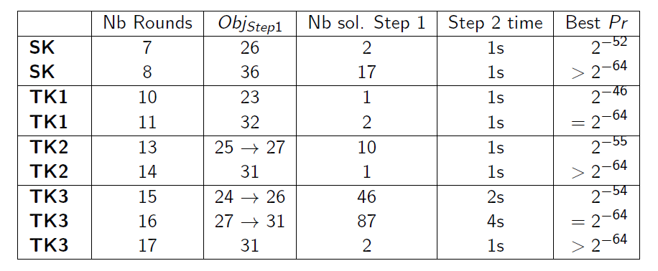
SKINNY-64: few seconds!
Limits: full code book = 2⁶⁴ thus Pr > 2⁻⁶⁴
40/44

Slide 42
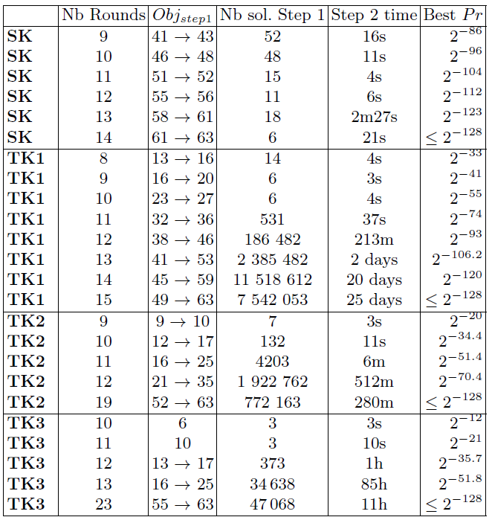
SKINNY-128: push the limits!
Limits: full code book = 2¹²⁸ thus Pr > 2⁻¹²⁸
SK 14 rounds, Few minutes (vs 15 days before)!
But 25 days for TK1 and TK2 the holy Grail even with 128 threads and a different model...
The best TK2 solution has 15 rounds and a probability of 2^{-124.2} BUT maybe not.optimal…
TK3 only results with 1 active byte in each lane

Slide 43
Conclusion
I hope you understand what is differential cryptanalysis
I hope you understand why using automatic tools is important
And why the modeling step must be carefully done
A problem: « Mind you path » ToSC 2022
I hope you are ready for implementing differential cryptanalysis!
41/44

Slide 44
And because I love that
The best TK1 differential characteristic on 14 rounds with a probability of 2⁻¹²⁰
Thank You for your attention!
44/44

Slide 45
Bibliography
Cryptography: Theory and Practice
Stinson
CRC Press, 1995
Modern Cryptanalysis : Techniques for Advanced Code Breaking
Swenson
Wiley, 2008
The SKINNY Family of Block Ciphers and its Low-Latency Variant MANTIS
Beierle, Jean, Kölbl, Leander, Moradi, Peyrin, Sasaki, Sasdrich & Sim
CRYPTO 2016
MILP Modeling for (Large) S-boxes to Optimize Probability of Differential Characteristics
Abdelkhalek, Sasaki, Todo, Tolba & Youssef
ToSC 2017
45/44

